Slide 1
Probability and Random Process
Tutorial 1

Slide 2
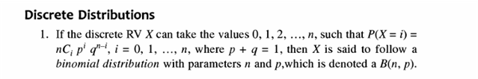
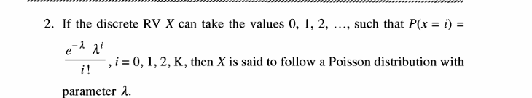
Prove that the Binomial Distribution will become Poisson Distribution if p → 0 and n → inf

Slide 3


Slide 4
